Slide 1
Cocoon Breaker
Final Report
Reporter: Liao Ziqiang
Sik Wanru
Cao Daoyin
Deng Mingyu
Date: June 2024

Slide 2
Contents
Intro
Future Outlook
Architecture
Main Challenges
Conclusion
Evaluation

Slide 3
01
Introduction

Slide 4
Introduction
Our Project, name as “茧房终结者” (Cocoon Breaker), is a project that uses advanced AI to help users break free from the information cocoon phenomenon caused by personalized content recommendation algorithms. This project aims to aggregate and organize diverse online information to provide users with a broader perspective and understanding, thereby enhancing information literacy and promoting social harmony.
Video Information: Provides video summaries and conducts searches based on extracted keywords.
Online Analysis: Uses system prompts and large models to generate analysis reports.
Comment Analysis: Focuses on sentiment recognition and text embedding.
Modular Architecture: Supports asynchronous processing and easy integration.

Slide 5
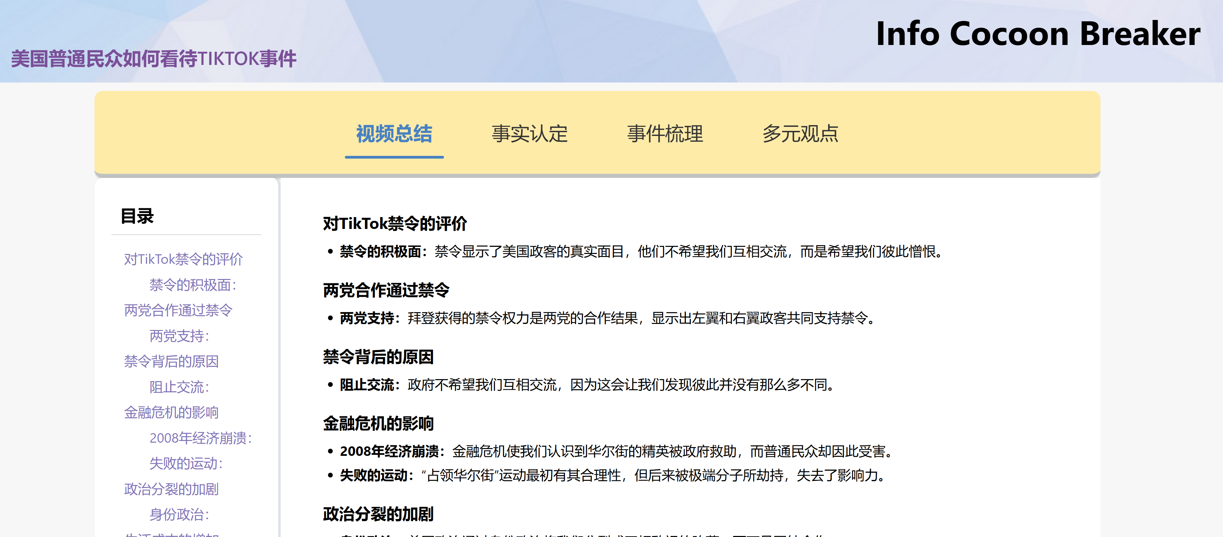
Introduction

Slide 6
02
Main Challenges

Slide 7
Main Challenges
Accuracy
Asynchronicity
Ensuring content and format accuracy, particularly compliance with HTML standards and predefined formats.
Managing the parallelization of tasks and the asynchronous design of the architecture, involving 11 main modules with complex dependencies, organized into a directed acyclic graph for simultaneous task execution and robust results.

Slide 8
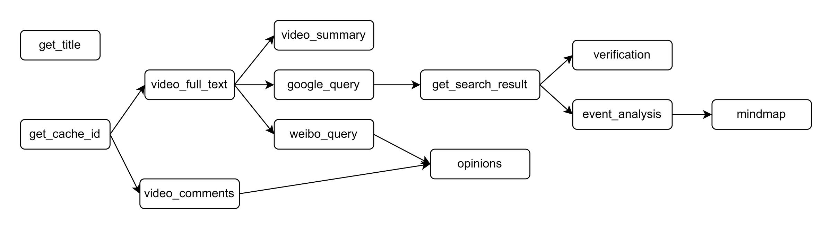
Main Challenges

Slide 9
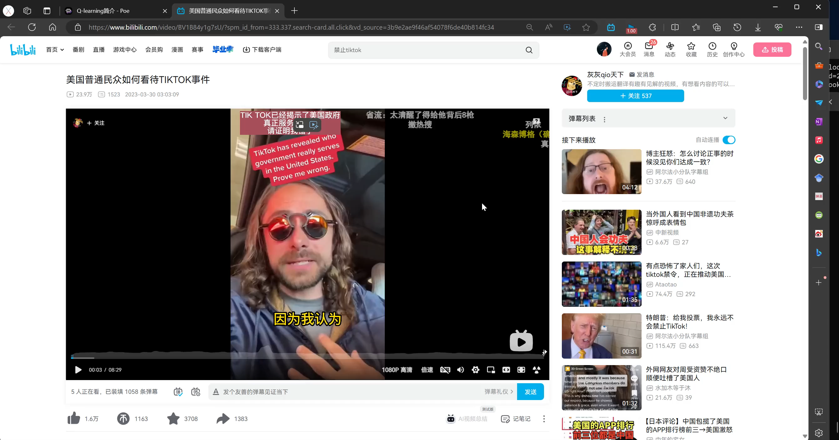

Slide 10
03
System Architecture

Slide 11
Liao
System Architecture
Module | Description | Technology/Tools
GPT Event Analysis | Uses Google API to search and analyze event information | Google API, OpenAI GPT-4o
Video Information Retrieval | Retrieves and converts Bilibili video data to text | Bilibili API, BeautifulSoup
Video Summarization | Summarizes video content and marks important timestamps | OpenAI GPT-4o
Search Keyword Extraction | Extracts search keywords from video transcripts | OpenAI GPT-4o
Comment Analysis | Analyzes comments from social platforms, returns as HTML | BeautifulSoup
Frontend Design | Builds interactive frontend pages | HTML, CSS, JavaScript
Django Backend | Integrates and deploys all modules, handles HTTP requests | Django
Text Embedding | Performs multilingual text embedding and clustering | BERT, K-means

Slide 12
Liao
System Architecture
Sentiment Analysis | Identifies text sentiment using multilingual models | bert-base-multilingual-uncased-sentiment
Video Processing | Extracts text and comments from videos | Bilibili API, iFlytek API, BeautifulSoup
Online Search | Conducts Google searches and scrapes results | Google API, BeautifulSoup
GPT Analysis | Summarizes and analyzes videos and events | OpenAI GPT-4o
Mind Map Generation | Converts analysis reports into mind maps | KityMinder
Opinion Analysis | Performs sentiment and clustering analysis | BERT, K-means

Slide 13
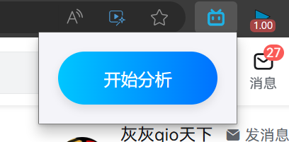
Liao
System Architecture
Backend Development (Liao)
The backend's main job is to bring together all the tasks effectively and correctly. We use Django as the backend platform because it is based on Python, which makes it easy for us to use different deep learning models, whether they are stored locally or accessed online.
Web Plugin(Liao)
Our application initially exists as a web plugin. When it's clicked, it automatically fetches the BV number of the video and sends it to the server.

Slide 14
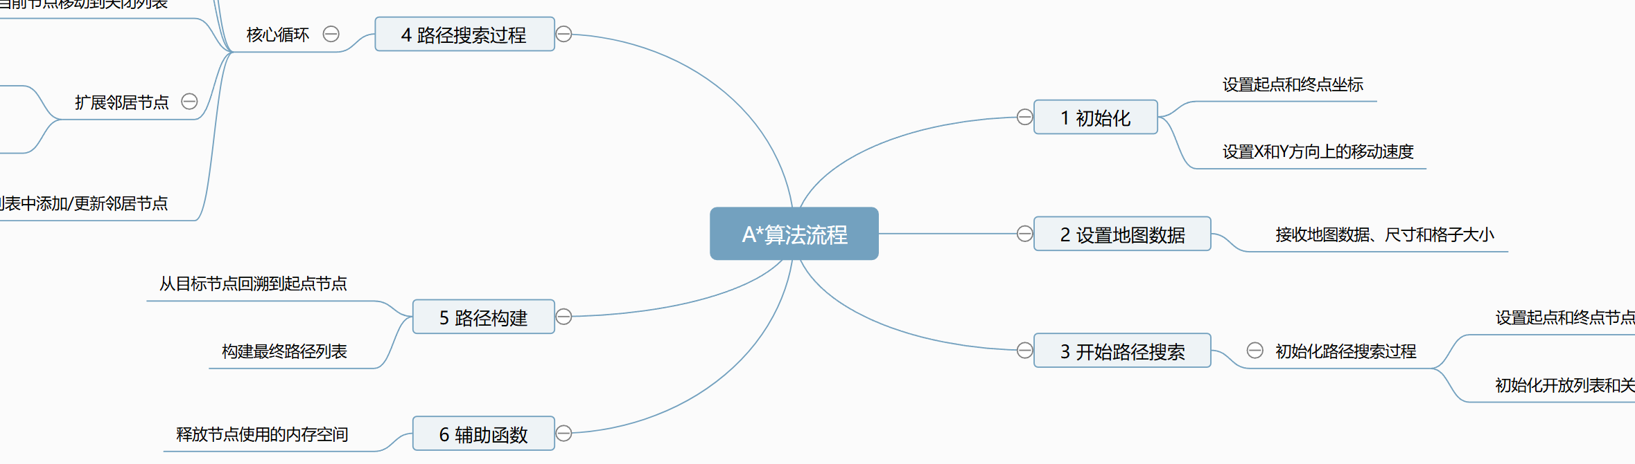
MindMap
Liao, Sik Wan Ru
Library: Use KityMinder by Baidu for interactive mind maps on web pages.
Accuracy: Ensure 100% accuracy by generating markdown text first, then converting it.
Tree Structure: Markdown represents a mind map's pre-order traversal, we need to restore the tree structure.
Robustness: This method maintains accuracy even with some errors.

Slide 15
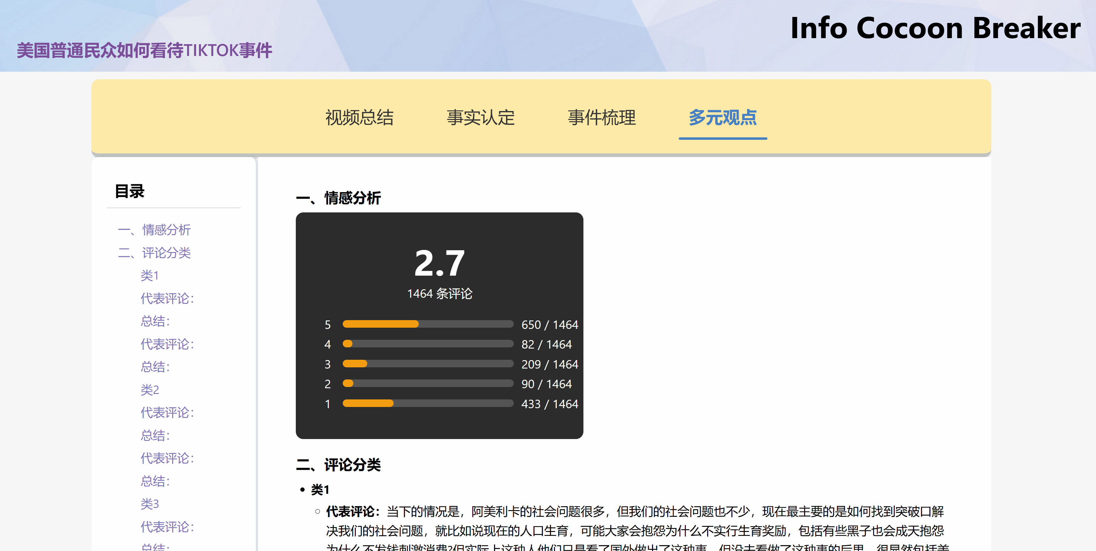
Opinion Analysis
Liao
Emotion Rating: The BERT-based model is used to assign scores ranging from 1 to 5, representing negative to positive emotions, and then the average score is calculated to obtain the final result.
Text Extraction: The BERT-based model is used for word embedding, followed by K-means clustering. The representative comments are determined by evaluating the scores of each comment based on the distance from the cluster center and the length of the comment. This approach ensures both representativeness and quality.

Slide 16
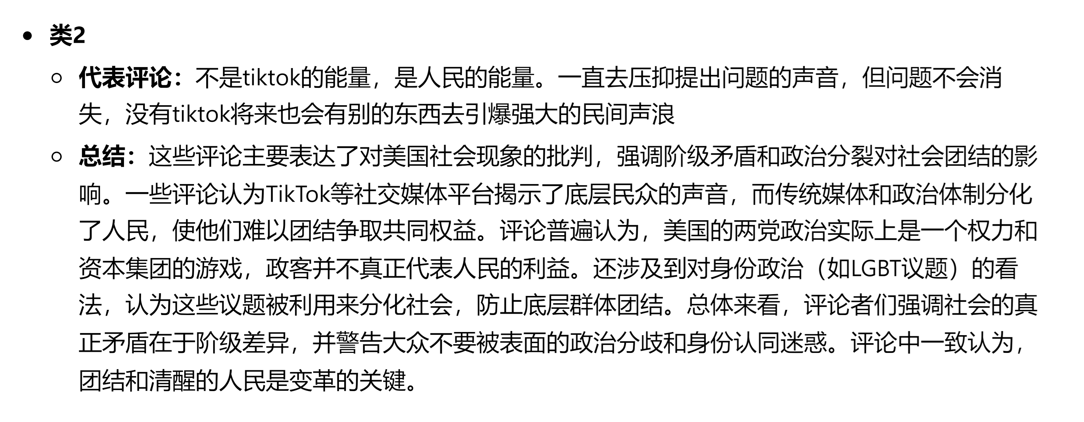
Opinion Analysis
Liao

Slide 17

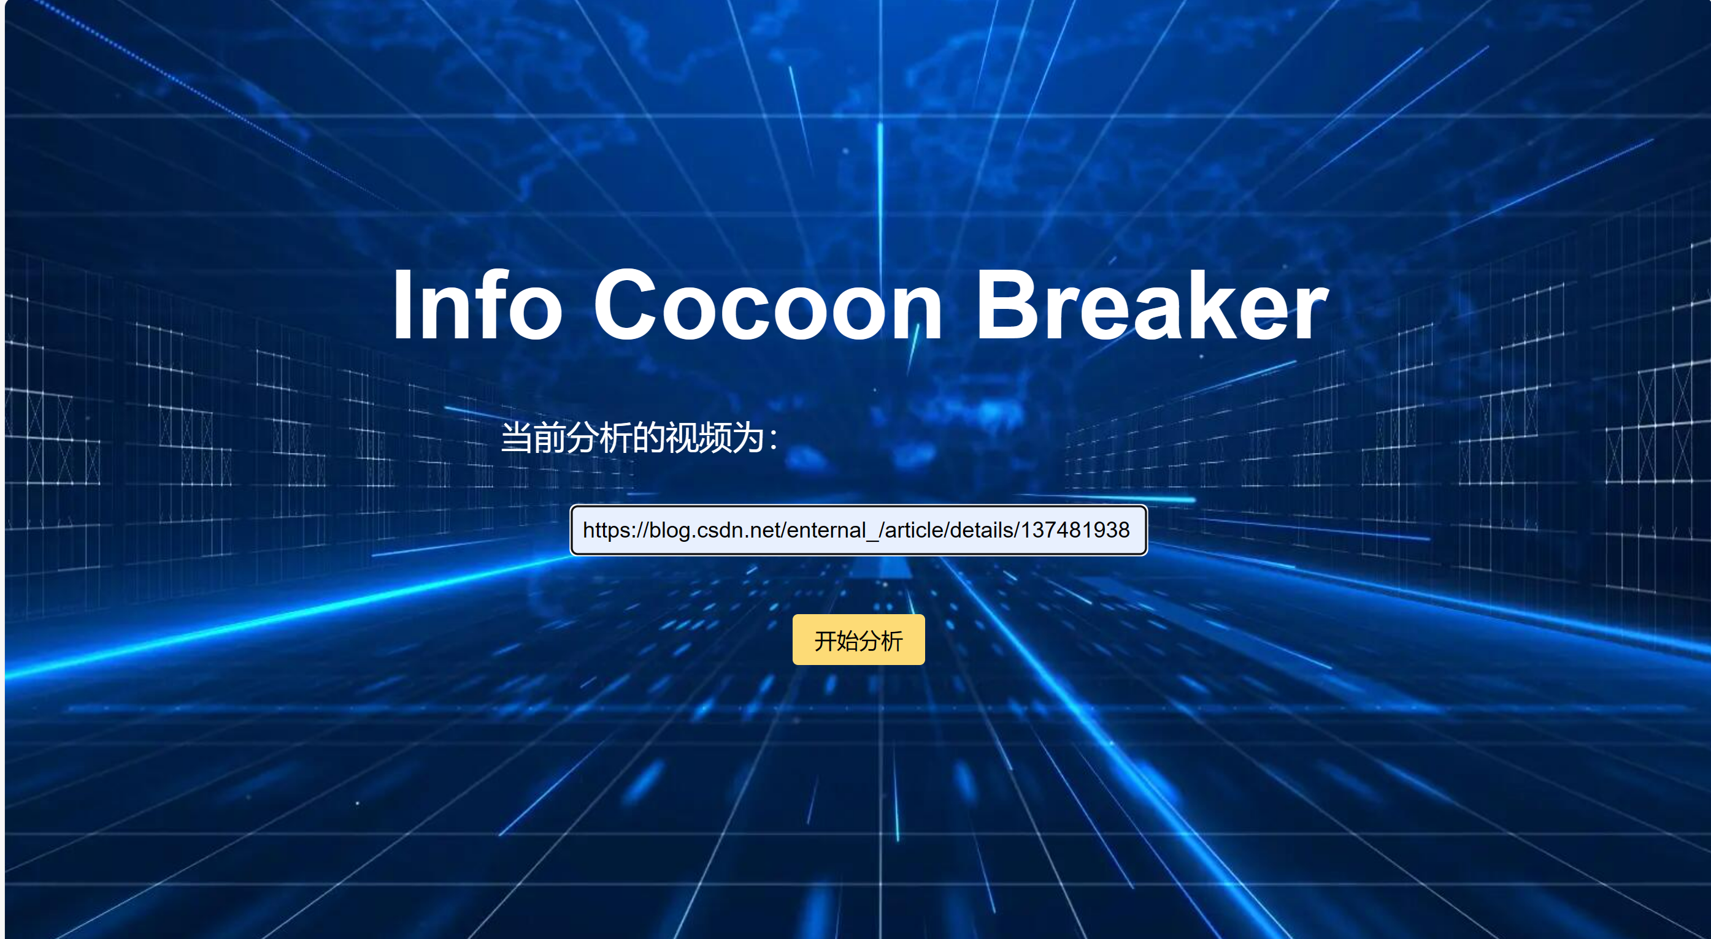
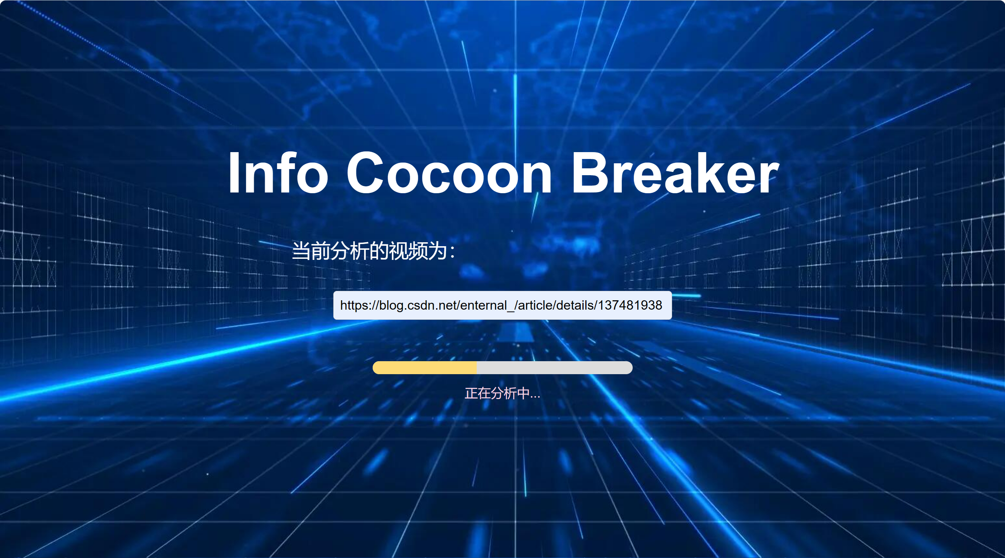
Fontend
Cao

Slide 18
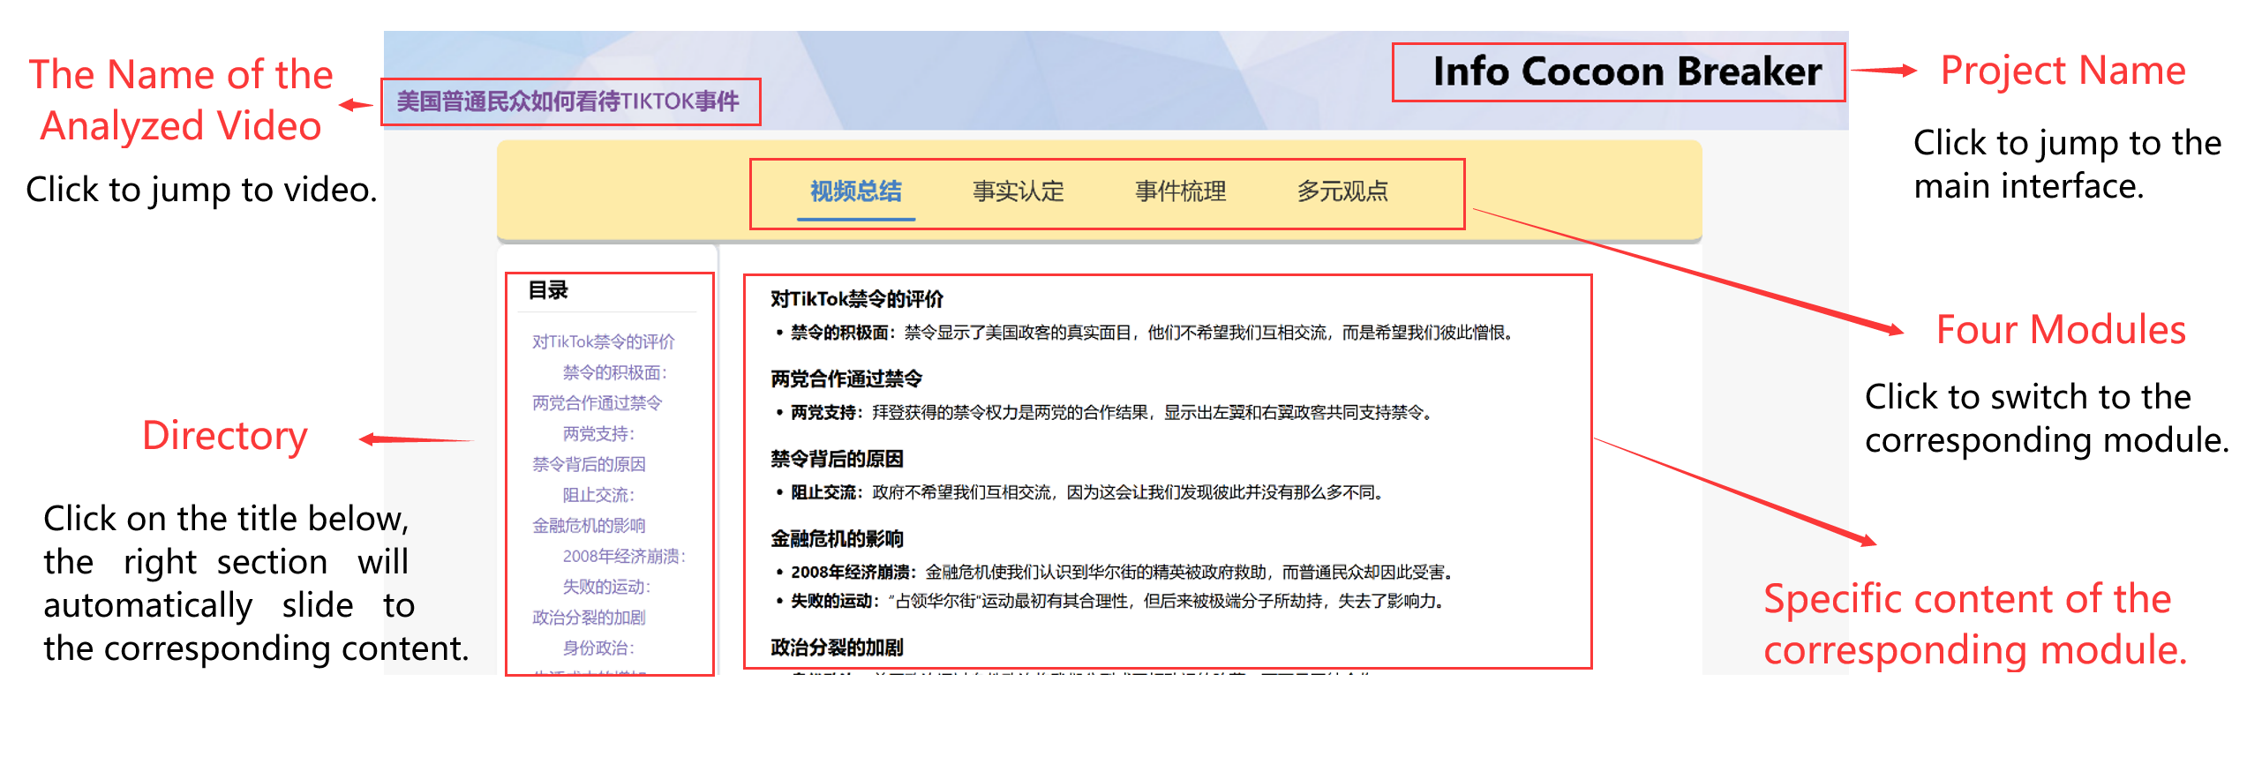
Fontend
Cao
Automatically generate directories based on content

Slide 19
Fontend
Cao

Slide 20
Cao
Video Summarization
Objective: Generate accurate video summaries using GPT-4o.
Method: Iterative testing with 8 text types to refine prompt instructions.
Process: Initial testing had a 78.05% success rate; adjustments improved it to 90.24%.
Outcome: Final optimization achieved a 100% success rate with no errors.

Slide 21
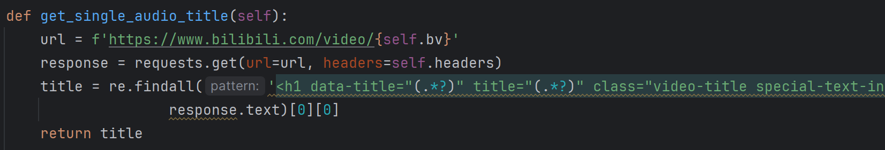
Video Processing
Deng
Video Information Retrieval
Function: Obtain video title information using a Bilibili BV number. Process Flow:
HTTP Request: Send an HTTP GET request to retrieve webpage content.
Regular Expressions: Use regex to parse webpage content and extract information.
JSON Parsing: For video collections, parse JSON data to obtain video information.

Slide 22
Video Processing
Deng
Video Text Extraction
Function: Download audio from a Bilibili video using a BV number and convert it to text using iFlytek Speech-to-Text API. Process Flow:
Obtain Video Title and Audio Link.
Download Audio File and Convert to WAV Format.
Upload Audio File to iFlytek API in Chunks.
Merge Audio Chunks and Convert Speech to Text.
Save Results to a Text File.
Video Comment and Danmu Crawling
Function: Retrieve video danmaku and comment data. Process Flow:
Danmaku Retrieval:
Initialize with BV number and cookie.
Obtain CID using BV number.
Get danmaku XML data using CID.
Parse XML data for danmaku content.
Convert to Pandas DataFrame and save as CSV.
Comment Retrieval:
Initialize with BV number and cookie.
Obtain AV number using BV number.
Construct API request URL and retrieve comment data.
Extract content, time, user ID; handle pagination.
Convert to Pandas DataFrame and save as CSV.

Slide 23
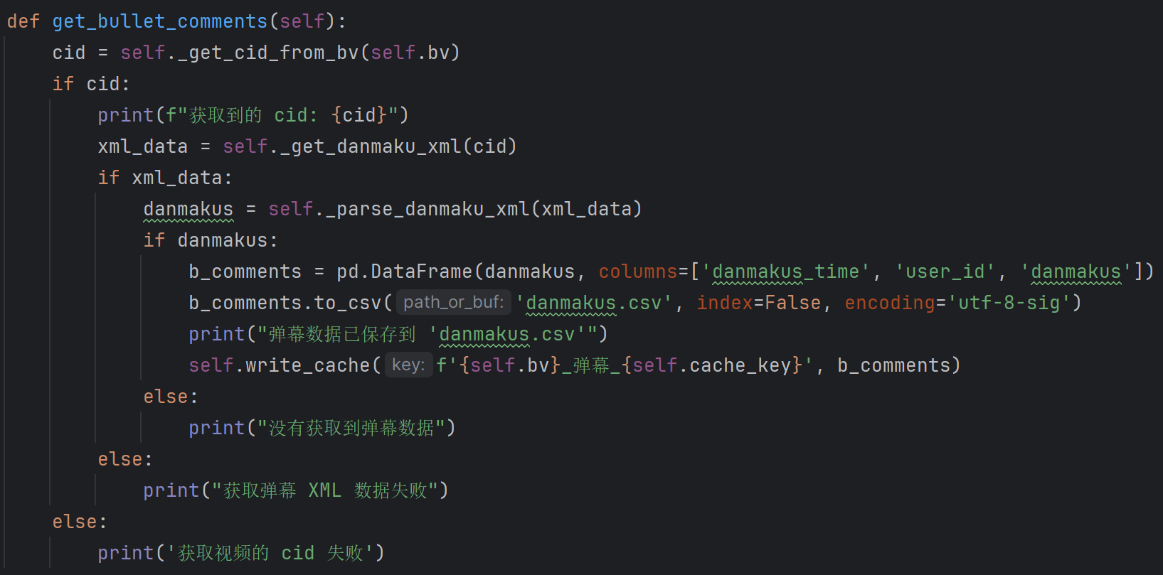
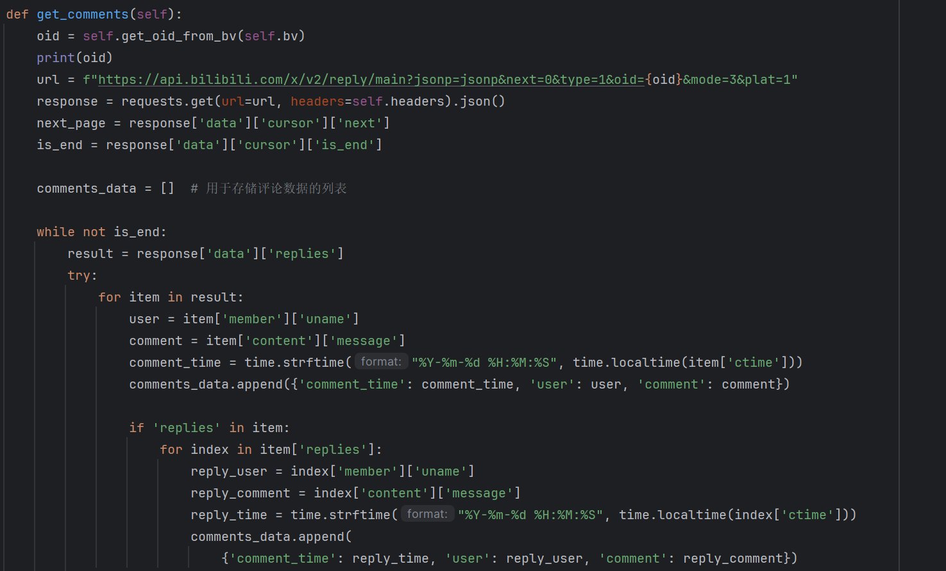
Video Processing
Deng

Slide 24
Video Processing
Deng
Extracting Search Keywords
Function: Summarize and condense video’s textual content using OpenAI's GPT-4o API. Process Flow:
Read Video File Content.
Use OpenAI's GPT API to Summarize and Condense Text.
Cache Results Locally.

Slide 25
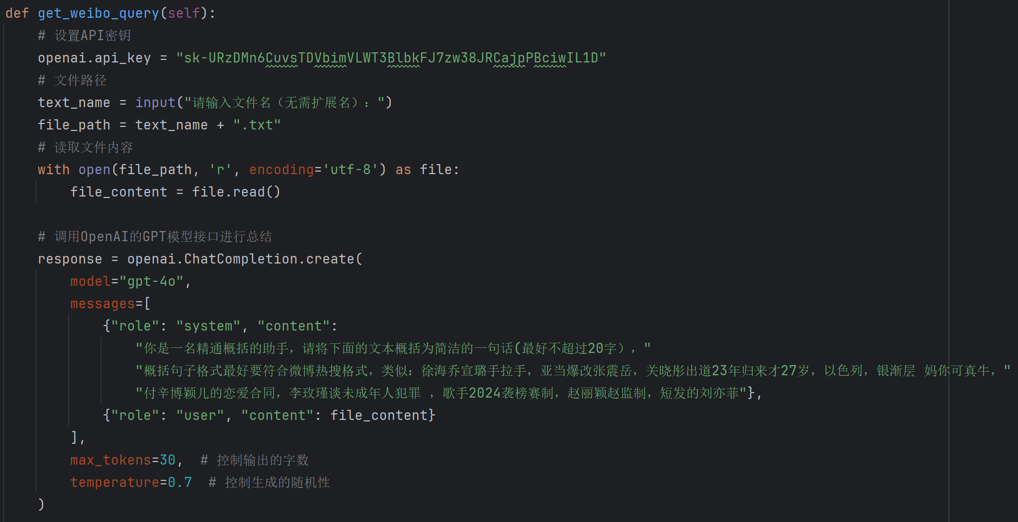
Video Processing
Sik Wan Ru

Slide 26
Online Search
Sik Wan Ru
Bilingual Search: Implements simultaneous Chinese and English searches using the Google Custom Search API.
AI Translation: Leverages OpenAI's GPT model for automatic translation between Chinese and English.
Content Extraction: Uses BeautifulSoup for extracting web content from search results.
Concurrent Processing: Accelerates processing with Python's concurrency features.
Enhanced Efficiency: Integrates these technologies to improve the efficiency and accuracy of information retrieval.
Multilingual Support: Provides robust support for research involving multilingual content and complex network environments.

Slide 27
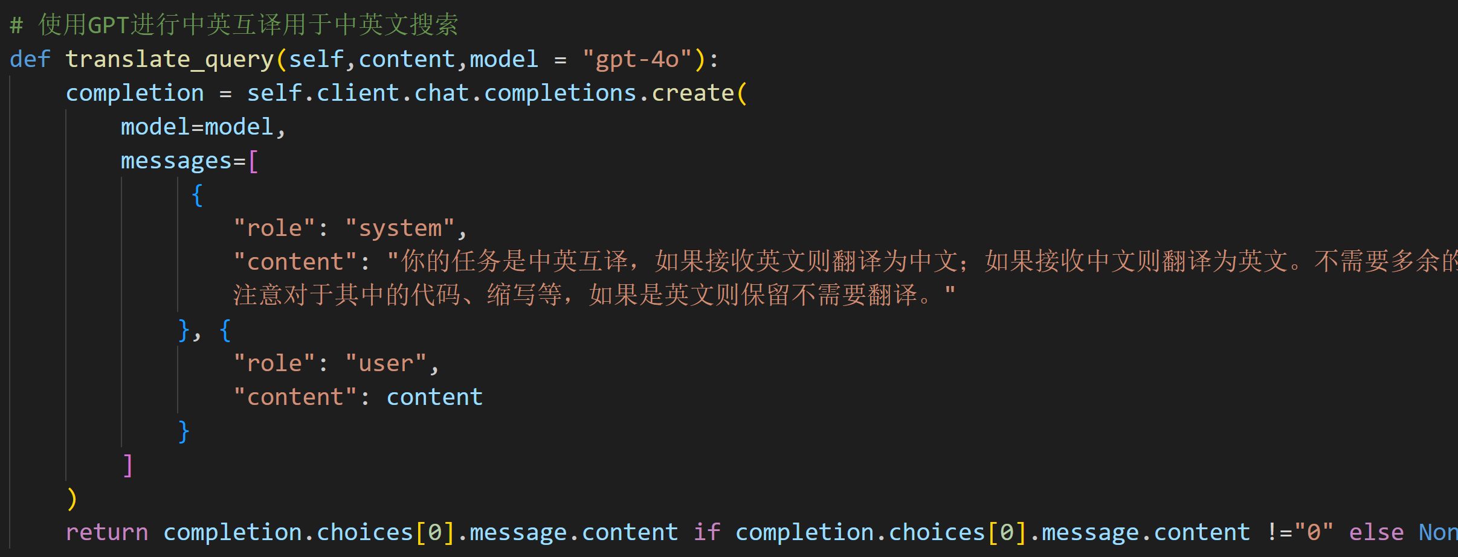
Online Search
Sik Wan Ru

Slide 28
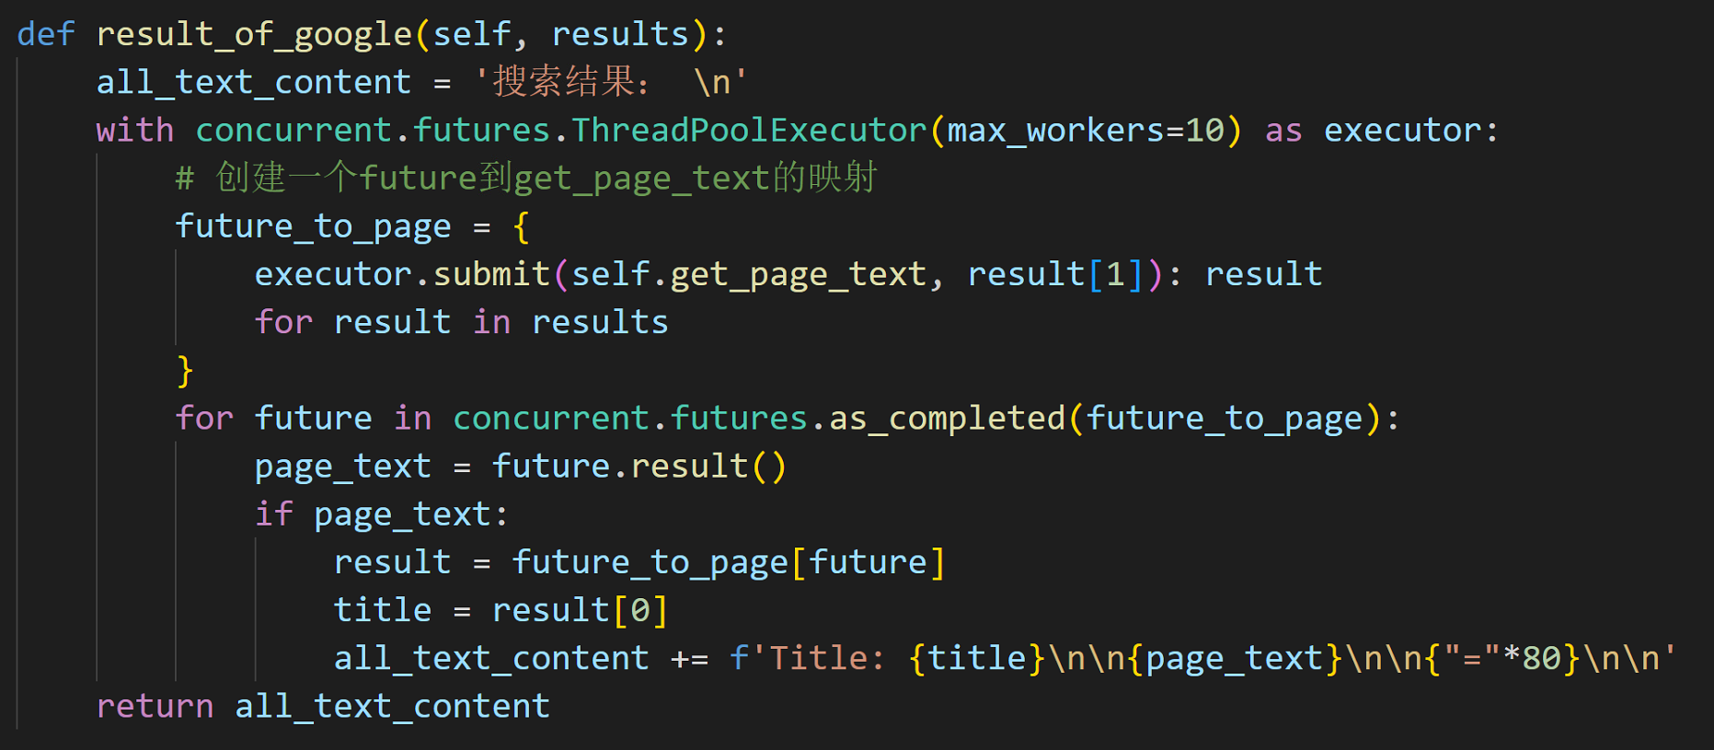
Online Search
Sik Wan Ru
Figure: concurrently fetch the web page content of Google search results

Slide 29
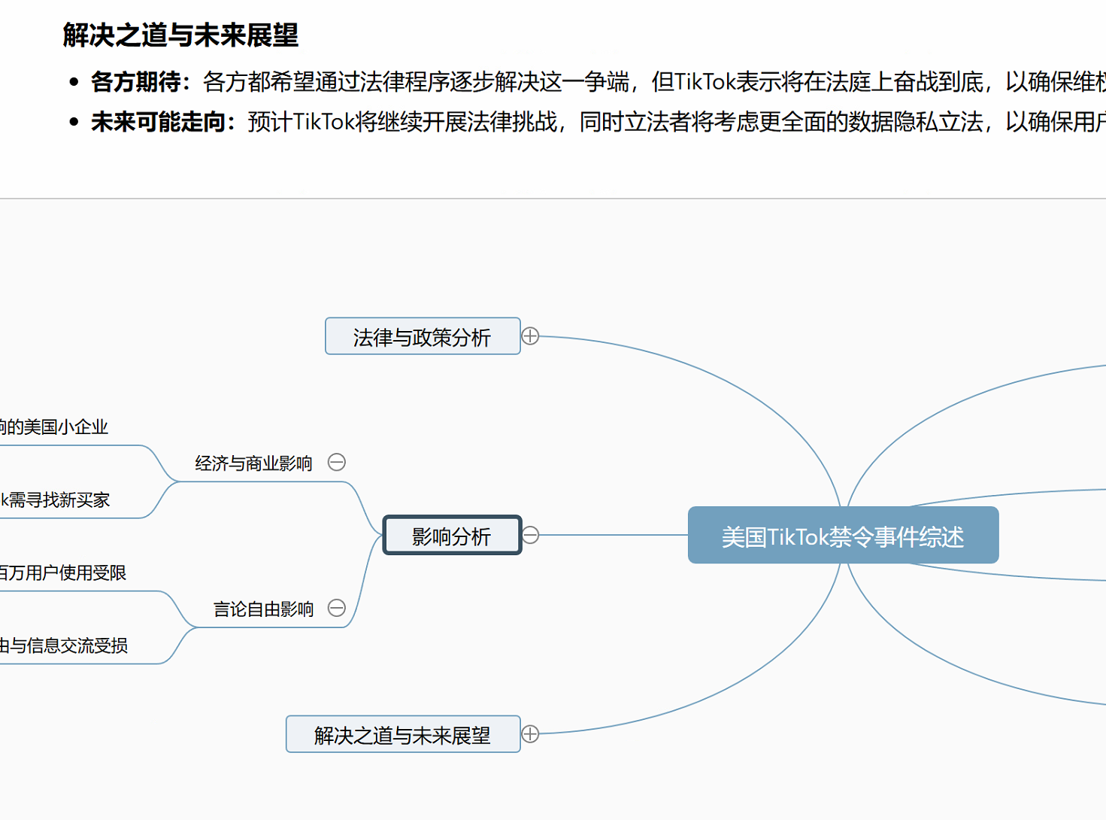
Event Analysis
Sik Wan Ru
Event Analysis
Purpose: Performs event analysis and generates HTML-formatted reports using the OpenAI GPT-4o model.
Initialization: Loads necessary data from the cache and initializes the OpenAI client for NLP tasks.
HTML Report Generation: Uses combined text data to generate detailed HTML analysis reports.
Process Flow: Combines text data, generates HTML reports, caches the results, and returns the HTML content.
Conclusion: Integrates GPT-4o with cached data to provide structured and comprehensive event analysis, aiding in decision-making.

Slide 30
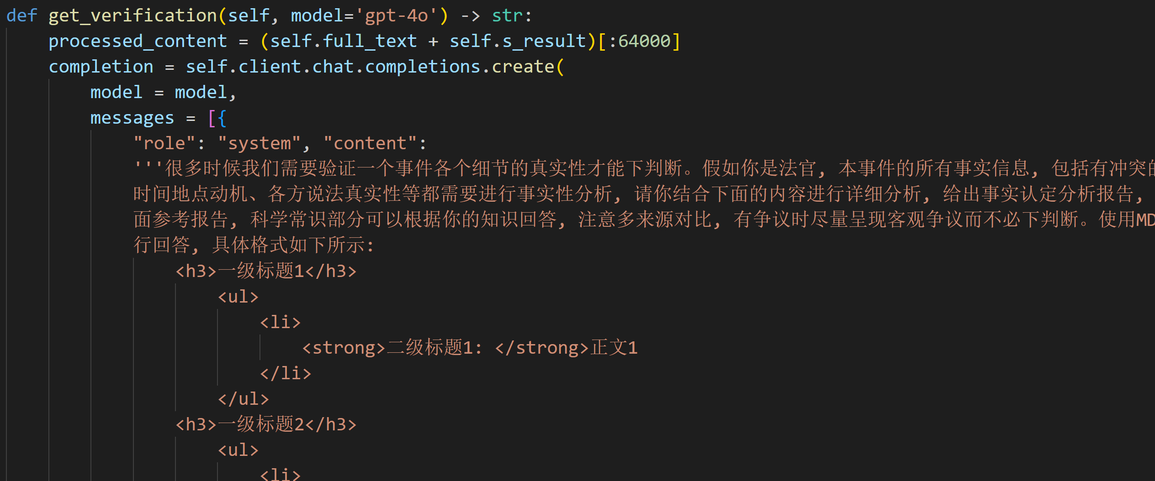
Fact Verification
Sik Wan Ru
Purpose: Verifies event authenticity and generates comprehensive reports.
Initialization: Loads essential text data from the cache and establishes connectivity with OpenAI.
Report Generation: Uses the GPT model to create detailed Markdown verification reports.
Verification Scope: Analyzes various event aspects such as time, location, motives, and credibility of statements.
Objective: Provides objective and accurate reference information for decision-makers.

Slide 31
04
Evaluation

Slide 32
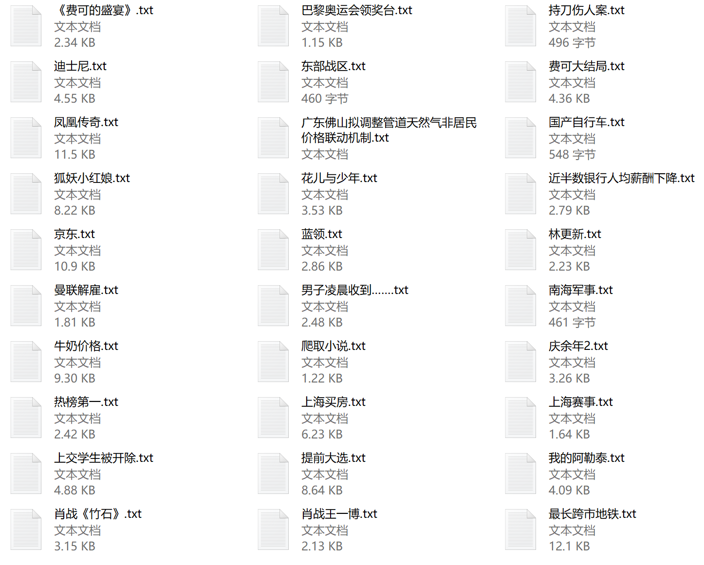
Samples

Slide 33
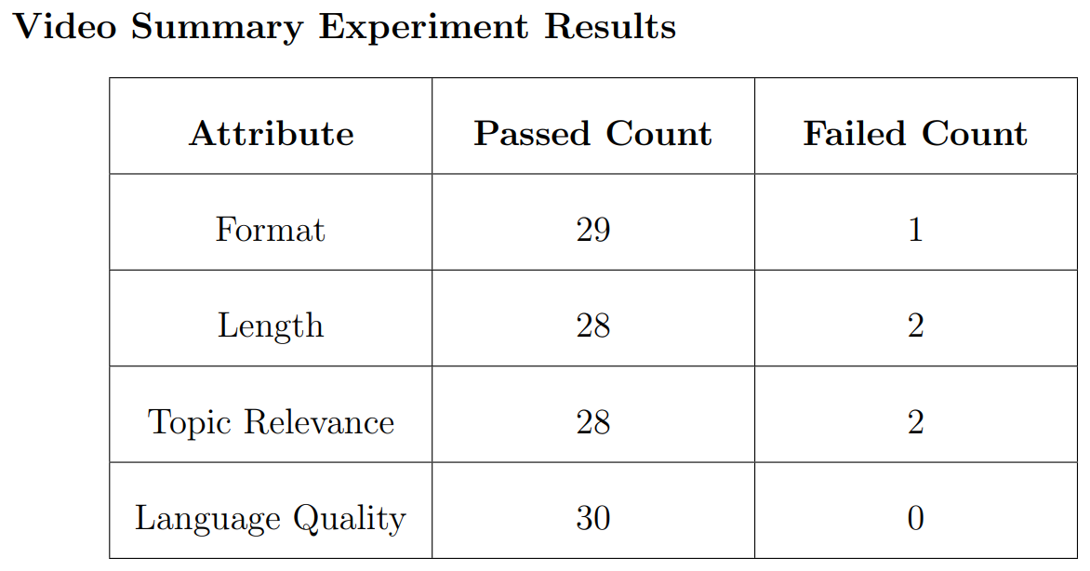
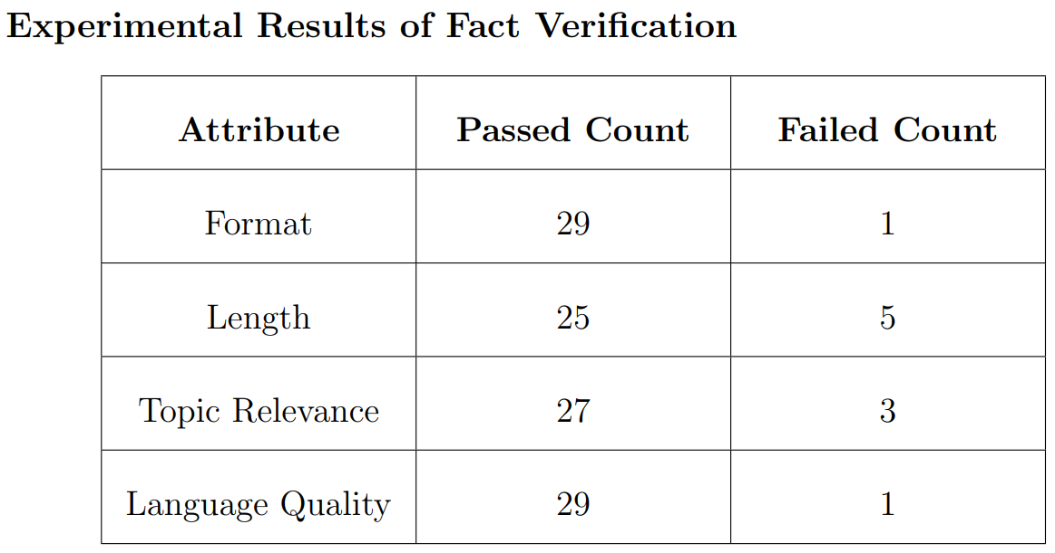
Stability

Slide 34
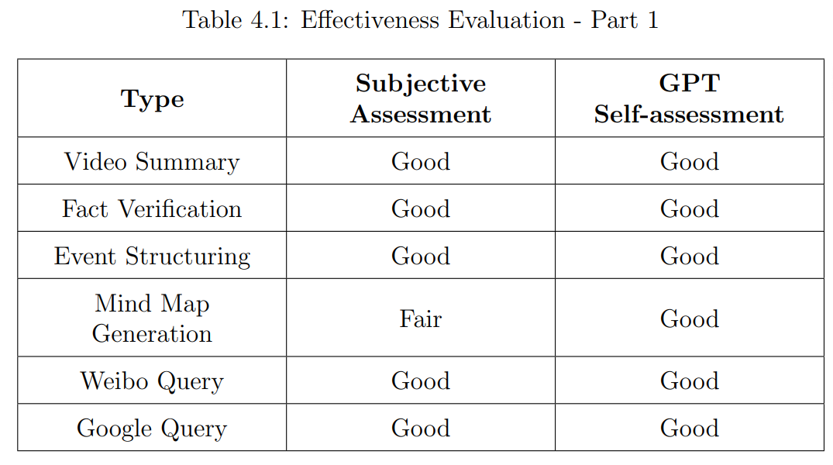
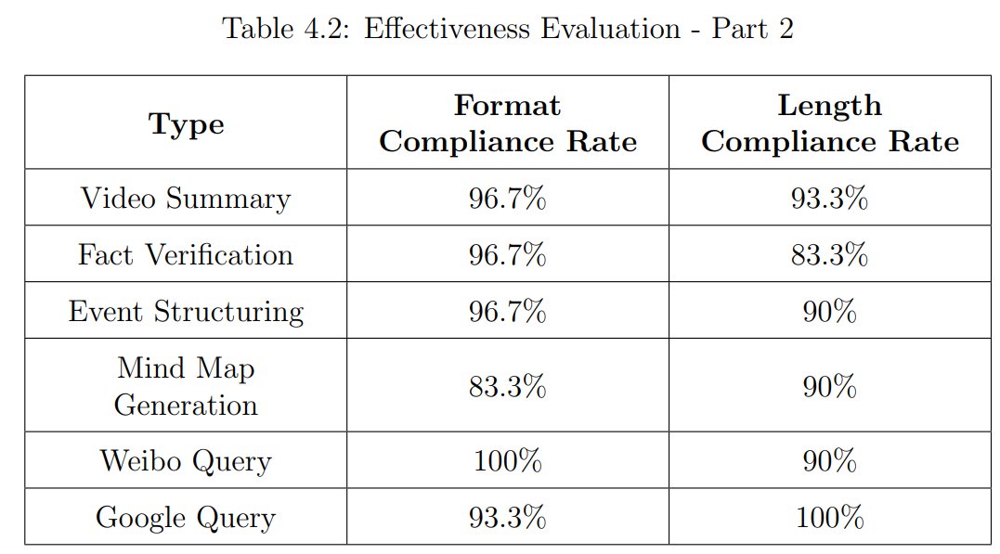
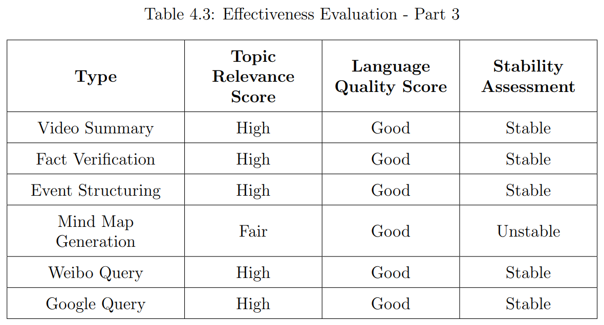
Effectiveness

Slide 35
Duration
· The average total time for all topics is about 5.2 seconds, ranging from 4.7 to 5.7. Performance is consistent across different topics.
· The generation speed of GPT-4o is 1,000 tokens every 30 seconds, and even with asynchronous processing, it still results in a relatively slow speed.
· The total time required for this project is approximately 2 to 5 minutes, which is generally acceptable.

Slide 36
05
Future Outlook

Slide 37
Future Outlook
· Model Cost: Balance cost and effectiveness with local and online models.
· User Account: Enable history tracking, favorites, and sharing for personalized experience.
· Workflow Optimization: Improve analysis workflow with automation and dynamic adjustments.
· Multi-Platform Support: Expand to reach broader, younger audience on TikTok and news portals.
· Hot Topic Recommendations: Increase engagement with personalized hot topic suggestions.
· Interactive System: Enhance user experience with real-time Q&A and social features.

Slide 38
06
Conclusion

Slide 39
Conclusion
The "Cocoon Breaker" project helps people access different information and learn from diverse perspectives. It uses cutting-edge AI technology to make sure everyone gets a wide range of knowledge. We want to keep improving the project to make it cheaper, let people create accounts, make it easier to use, work on different platform, more interactive and so on. In general, this project is highly practical. Moreover, it has a high overall completion level and is already ready for deployment.

Slide 40
Thanks

